Slide 1

WK08: Data Issues
PPOL 5206 – Spring 2025

Slide 2
Data Governance

Slide 3
Data Governance Issues
Maintaining a “Single Source of Truth”
Who is allowed to ____ the data?
Access
Move
Change
Stakeholders
Users
Customers (ID theft)
Researchers
THE LAW
Different regulations in different storage locations
Others?

Slide 4

The Data LifeCycle
Ingestion
Storage
Processing
Analysis
Archiving and Retention
Deletion

Slide 5
Principles of the Data Lifecycle
Governance:
Establish clear policies for data access, quality, and compliance.
Scalability:
Design pipelines to handle growing data volumes and velocity.
Security:
Protect data at every stage with encryption, access controls, and monitoring.
Automation:
Leverage tools and scripts to automate repetitive tasks (e.g., Airflow, Lambda).
Feedback Loops:
Continuously improve processes based on analysis and new requirements.
End-to-End View:
Remember: Each stage impacts the next. Poor ingestion or storage leads to unreliable insights.

Slide 6
Snapshots

Slide 7
RDS and EBS Snapshots
Allows you to take a point in time “photo” of your data
Database
Data cluster
Stored in S3
Can be shared with another region or AWS accounts
Once shared, can be copied and reshared
Can be changed to a different version of the database
Billed for incremental storage use
Up to 100 per region
Elastic Block Store (EBS) is used with EC2 instances

Slide 8
Snapshot uses
Share data:
Other organizations
Other users in the same organization
With future self
Within AWS sharing is:
Fast
Secure
Retain data
Recovery
Replication (development and testing)
Rerun models or test different models
Auditing and compliance

Slide 9
Snapshots allow system restores
Can change storage version:
SQL express to SQL server
Incremental storage:
“12345”
“123456” = “12345” + “6”
The first snapshot is a full copy, others are “delta loads”
Because snapshots are incremental, deleting one snapshot might not reduce costs, if data are used by other snapshots

Slide 10
 | Snapshot | Backup
Happens | When user executes it | Automatically (Scheduled) [Max 35 days]
Remains | Until deleted (if manual) | Specified length of time
Number | 100 / region | 40 / region
Copyable? | Yes | Yes

Slide 11

Endpoints
Treated as the “host” for some service to connect to
Same as the URL for the data point
Allows database programs (DBeaver, SQL Server) to connect to a cloud service

Slide 12
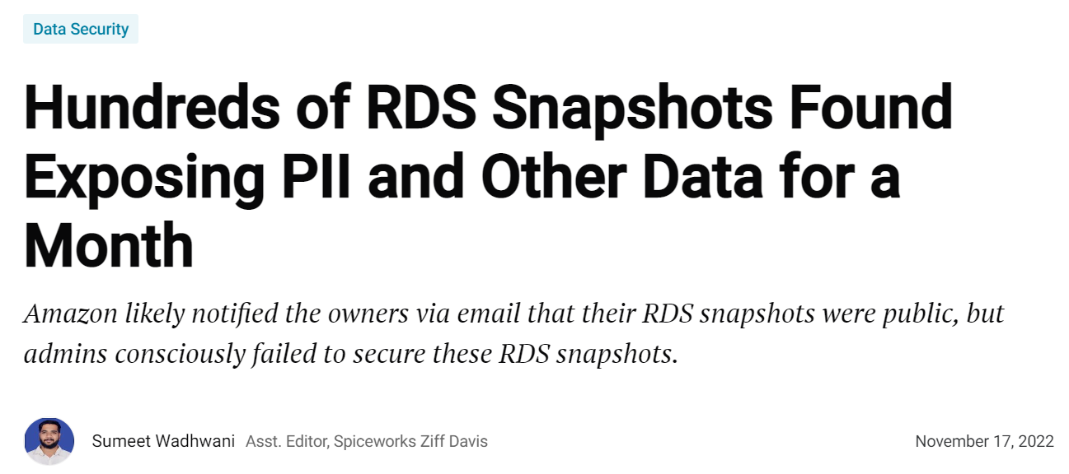
Be careful what you share!
Private Data:
PII
PHI
Proprietary
Damages:
Reputational
Legal
Business

Slide 13
Disaster Recovery

Slide 14

DR: Disaster Recovery
Backup & restore plan is the:
Simplest
Cheapest
AWS allows a combination of:
Automatic backups
Manual backups
Planning:
Before system changes
How much data can be lost?
How much downtime is affordable?
Backups vs Disaster Recovery

Slide 15
Questions for designing a recovery system
What workload type do you want to protect?
Centralized vs decentralized
What granularity is needed?
Consistent, crash consistent, or log
Are the compliance requirements?
Data residency constraints?
What is the required RPO and RTO?
Recovery Point Objective (RPO): How much data loss is acceptable?
Recovery Time Objective (RTO): How long can systems be down?
How long do you need to retain backups?
Source: Guidance and best practices - Azure Backup | Microsoft Learn
Notes:
Disaster recovery involves a set of policies, tools, and procedures that enable the recovery of vital technology infrastructure and systems following a disaster. Let's define some key terminology that forms the foundation of any disaster recovery strategy:
First, we have Recovery Time Objective (RTO), which is the maximum acceptable time it should take to restore normal operations after a disaster. For a recommendation system in e-commerce, an RTO might be measured in minutes; for a quarterly forecasting model, it might be measured in days. The question to ask yourself is: "How long can my model or data pipeline be offline before significant damage occurs to the business?"
Next is the Recovery Point Objective (RPO), which defines the maximum amount of data loss that's acceptable, measured in time. An RPO of 4 hours means you're willing to lose up to 4 hours of data changes in a disaster scenario. For streaming data science applications processing real-time data, the RPO might need to be seconds; for models that update weekly, a longer RPO might be acceptable.
Business continuity is a broader concept that encompasses disaster recovery. While disaster recovery focuses on restoring IT assets and data, business continuity addresses how the entire organization maintains essential functions during and after a disaster.
It's important to understand the difference between disaster recovery and simple backup. Backing up data is just one component of disaster recovery. A true disaster recovery strategy includes processes for restoring entire systems, redeploying models, reconstructing environments, and ensuring that the appropriate personnel know their responsibilities when disaster strikes.

Slide 16
Disaster Recovery Planning Process
Business impact analysis:
identifying critical data assets in data science workflows
Risk assessment:
evaluating threats to data science infrastructure
Recovery strategy development:
techniques tailored for different types of data science assets
Testing and maintenance:
ensuring DR plans remain viable as data volumes grow

Slide 17
Backup Best Practices
Regular and frequent backups
Use multiple methods
3-2-1 rule: 3 backups, 2 methods, (at least) 1 offsite
Prioritize off-site storage
Endpoint backups: Desktops, laptops, mobile
Encrypt backup data
Test system regularly
Determine a retention policy

Slide 18
System recovery
Same time, different locations
Different time, same location
Examples:
Grandfather
Father
Son
3-2-1 Rule
Notes:
For data scientists specifically, disaster recovery takes on some unique dimensions. Consider the assets you work with daily:
Training datasets that may have undergone extensive cleaning and preprocessing
Feature stores that feed your models
Notebooks containing your analysis and modeling code
Model artifacts including weights, hyperparameters, and evaluation metrics
Deployment configurations for models in production
Data pipelines that gather, transform, and deliver data to your models
Each of these assets requires different recovery approaches. Losing a trained model might mean days or weeks of retraining on expensive compute resources. Losing the exact version of a dataset used to train a regulated model might create compliance issues. Losing documentation about how a model was created might render the model unusable, even if the artifact itself is recovered.

Slide 19
“Generations rule” in Cloud Computing
The traditional rotation scheme for creating generational backups still applies in cloud environments:
Son backups: Daily incremental backups (retained for a week)
Father backups: Weekly full backups (retained for a month)
Grandfather backups: Monthly full backups (retained for a year or longer)
Cloud implementations benefit from:
Automated backup scheduling and retention policies
Cost-efficient storage tiers for different generations (e.g., archive storage for grandfather backups)
Point-in-time recovery options
Immutable backup options to prevent tampering
The core principles remain valid, but cloud computing provides more flexible, automated, and often more cost-effective ways to implement these time-tested backup strategies.

Slide 20
3-2-1 Rule in the cloud?
The traditional 3-2-1 rule recommends:
3 copies of your data
2 different storage types
1 copy offsite
Cloud?
Multiple regions?
Multiple clouds?
3-2-1-1-0" approach: 3 copies, 2 different media, 1 offsite copy, 1 air-gapped/immutable copy, 0 recovery errors

Slide 21
Using Cloud Backups
Adding immutability/air-gapping to counter ransomware threats
Using multiple cloud regions or providers for geographic diversity
Implementing appropriate access controls and encryption
Leveraging storage tiers to balance cost and performance
Regular testing of recovery processes

Slide 22
Other Issues

Slide 23
Backup as a Service (BaaS) and DRaaS
Introduction to BaaS and DRaaS:
BaaS and DRaaS are cloud-based services that offer managed backup and disaster recovery solutions.
These services help businesses enhance their data resilience and recovery capabilities.
Benefits:
Cost Efficiency: Reduces the need for on-premises infrastructure and maintenance.
Scalability: Easily scale backup and recovery solutions as business needs grow.
Reliability: Provides robust and reliable backup solutions with professional management.

Slide 24
Case study: Blockchain (Not just for scams)
Immutability:
Blockchain ensures that once data is written, it cannot be altered or deleted, providing a tamper-proof record of backups.
Decentralization:
By distributing data across multiple nodes, blockchain reduces the risk of data loss due to a single point of failure.
Transparency:
All transactions and changes are recorded on the blockchain, allowing for clear and transparent tracking of backup and recovery processes.
Security:
Blockchain uses cryptographic techniques to secure data, making it resistant to unauthorized access and cyberattacks.
Efficiency:
Automated processes and smart contracts can streamline backup and recovery operations, reducing the need for manual intervention.
Compliance:
Blockchain can help meet regulatory requirements by providing an auditable trail of data handling and storage activities.

Slide 25
Multi-Cloud and Hybrid Cloud Strategies
Introduction to Multi-Cloud and Hybrid Strategies:
Multi-cloud involves using multiple cloud service providers, while hybrid cloud combines on-premises infrastructure with cloud services.
These strategies enhance data protection and resilience.
Advantages:
Avoid Vendor Lock-In: Reduces dependency on a single cloud provider, enhancing flexibility.
Improved Availability: Ensures data availability and redundancy across multiple platforms.
Cost Management: Optimizes costs by leveraging different providers' strengths and pricing models.

Slide 26
Cost Optimization in Backup
Strategies for Cost Optimization:
Implementing efficient backup processes and storage management to reduce costs.
Using tiered storage solutions to match data importance with appropriate storage options.
Techniques:
Data Deduplication: Reduces storage requirements by eliminating duplicate data.
Compression: Lowers storage costs by compressing backup data.
Lifecycle Management: Automatically moves data to lower-cost storage tiers based on policies.

Slide 27
Enhancing Compliance and Security
Importance of Compliance and Security:
Staying updated with industry standards and regulations is crucial for data security.
Implementing robust security measures in backup solutions ensures compliance and protection against breaches.
Best Practices:
Regular Audits: Conduct regular audits to ensure compliance with regulations.
Encryption: Encrypt backup data to protect it from unauthorized access.
Access Controls: Implement strict access controls to manage who can access and modify backups.

Slide 28
Takeaways
Data governance is important beyond engineering roles
Backups are useful for:
Safety
Reproducibility
Compliance
Main concepts remain important, even as technology changes

